Slide 1
Amazon Review Research
Ryan Erwin

Slide 2
Overview - Processing
Grab Amazon customer product reviews and accompanying attributes for each review
Using the review text and product information, predict whether a customer will review a new product, given their past behavior
To gather the data, requires using R’s web scraping capability
rvest
stringr
httr
dplyr

Slide 3
Overview - Motivation
Amazon has a Top Reviewer program in place where they rank their top 10,000 reviewers. The list is updated every two days, but I’ve grabbed a snapshot of that list
The idea behind the project is that a prospective company would be interested in which Amazon customers are most likely to review a new product
If a company can more efficiently access their most vocal users, then it is a mutual benefit for both parties
The company is closer to its customers
The reviewer gains exposure to new products

Slide 4
Approach
Web scraping via R and RStudio
Gathering the data is most challenging element of the project
Rate limits, html parsing, string processing
https://github.com/rerwin21/amazon_research

Slide 5
Data
Review Text
Text Analysis
Rating
Helpful votes
Product information
Price
Quantity
Discount
Category
Reviewer information
Date

Slide 6
Data (cont’d)
The data is going to be analyzed and aggregated down to the reviewer level, where each row represents the information for a particular reviewer

Slide 7
Prediction
The response will be binary, 1 if a customer reviews a product and 0 otherwise
I am using the random forest algorithm for initial modeling, but I will consider another algorithm once I have a stable basetable
Every time I build a basetable, it will be for a particular product category: computer mouse, monitor, broom, men’s clothing, etc.

Slide 8
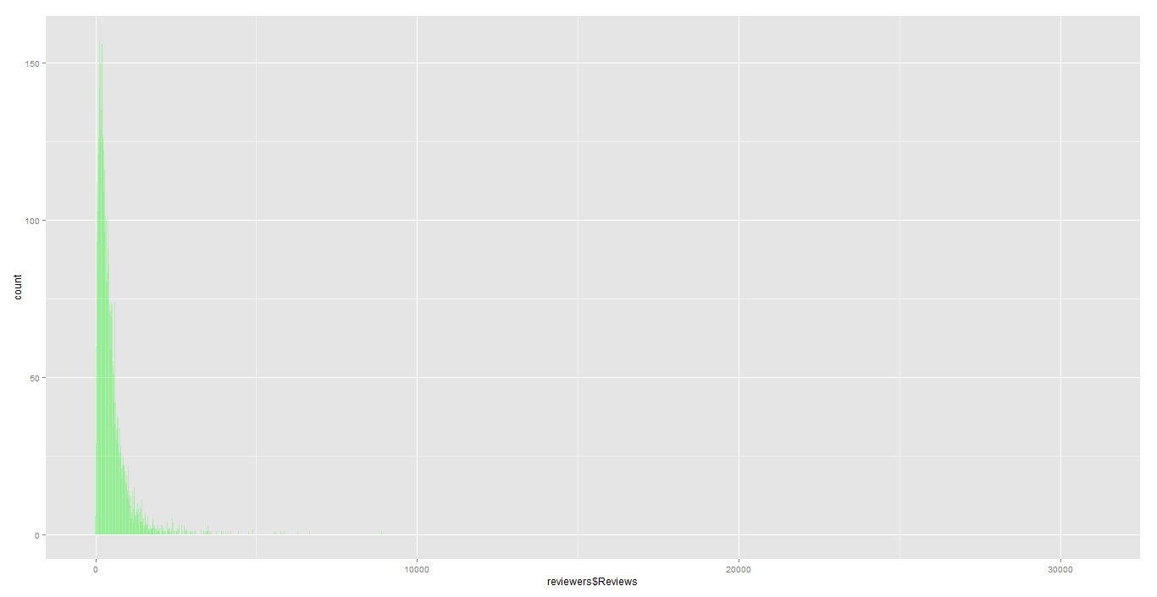
Distribution of Reviews (count)
Notes:
Median: 333.5: Mean: 487.5

Slide 9
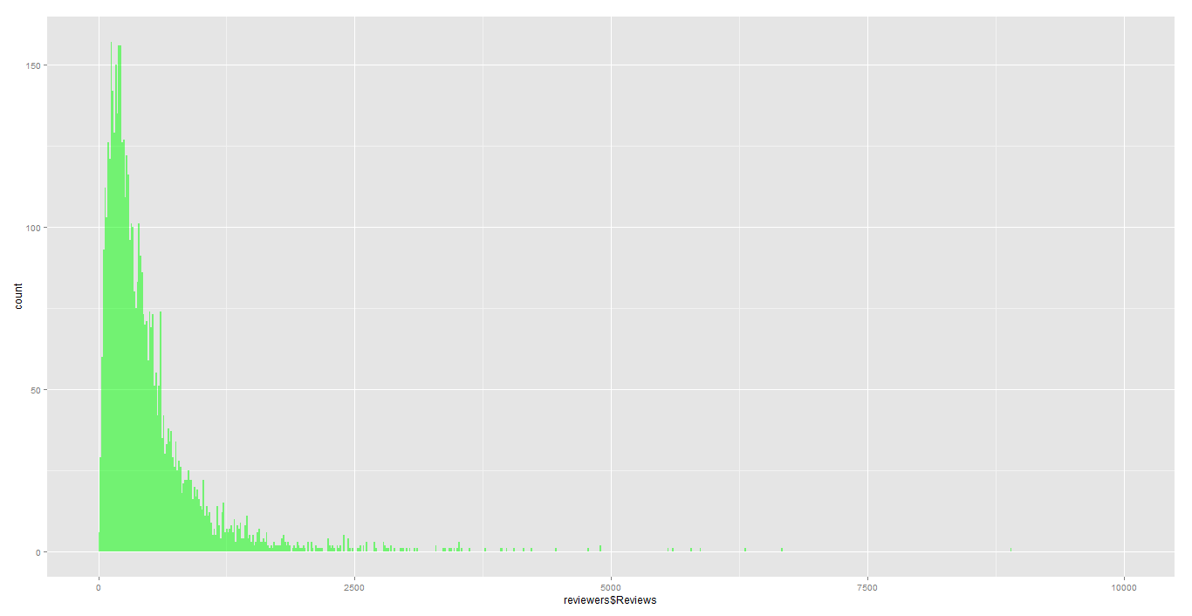
Distribution of Reviews (count)
Notes:
Median: 333.5: Mean: 487.5

Slide 10
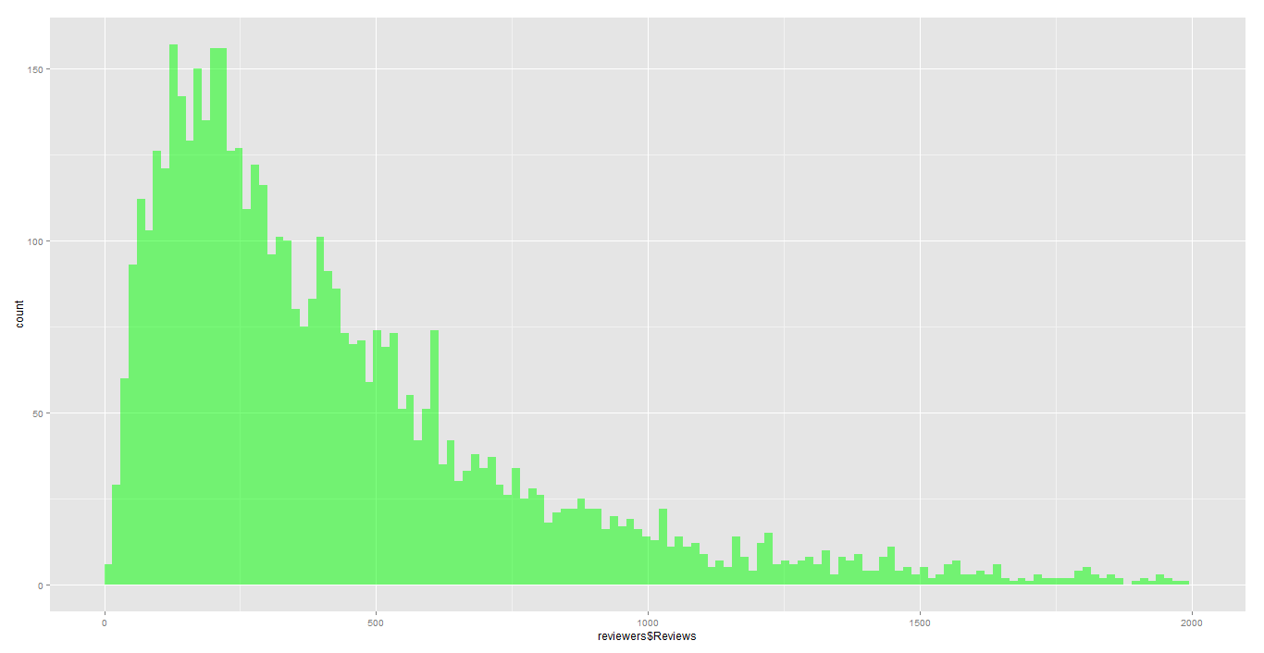
Distribution of Reviews (count)
Notes:
Median: 333.5: Mean: 487.5

Slide 11
Q&A

Slide 12
Amazon Review Research: Update
Ryan Erwin

Slide 13
Overview - Update
Due to Amazon’s throttling restrictions, I restructured the organization of the project
I’ve restricted the components to scrape
Time permitting, I’m going to use their API to grab product information
Product Advertising API
ItemLookup
If the original plan were to be implemented, I still need: Price, Category, size, etc.
You can follow the evolution of the project code at https://github.com/rerwin21/amazon_research
New tools include AWS, WinSCP, and PuTTY

Slide 14
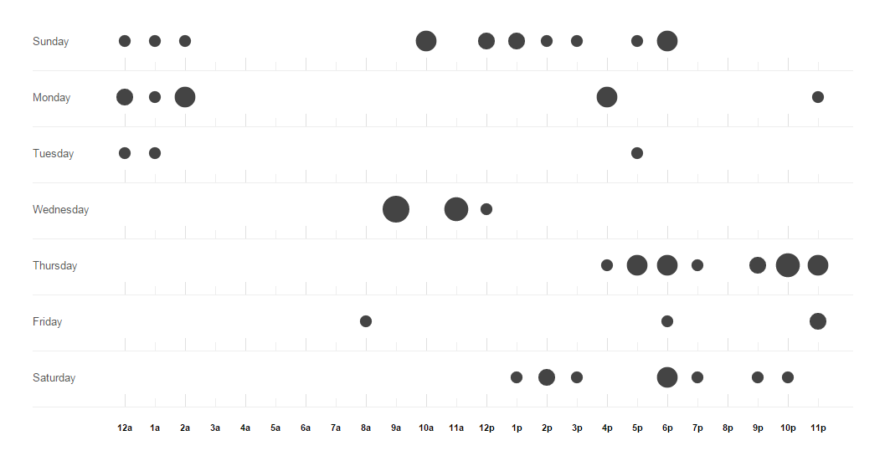
Overview – Update Cont’d
Lines | Words | Characters | File
486 | 1,342 | 13,160 | call_last_step.R
322 | 779 | 7,488 | data_last_step.R
144 | 380 | 3,651 | reviewers.R
52 | 117 | 1,128 | reviewers_script.R
57 | 154 | 1,457 | rvest_vs_RCurl.R
175 | 455 | 4,663 | text_mining.R
1,236 | 3,227 | 31,547 | Total

Slide 15
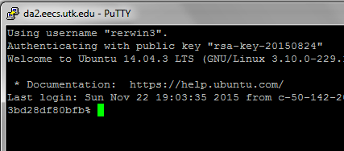
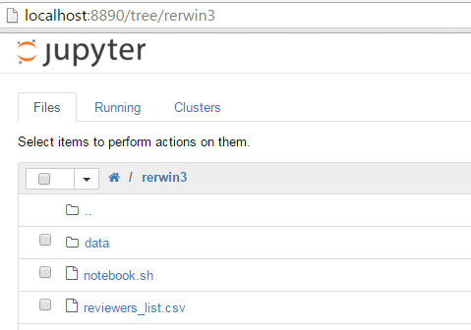
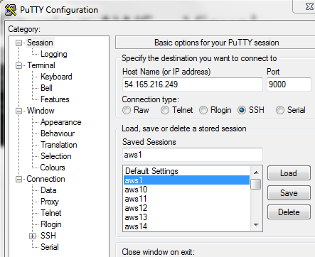
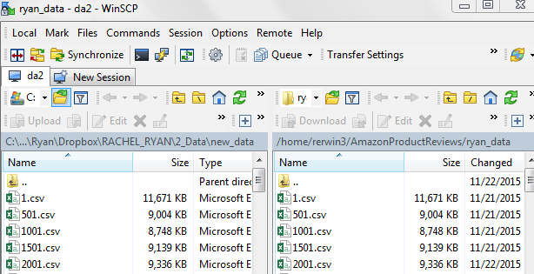
Configuring AWS
aws ec2 run-instances --image-id ami-cfe39eaa --count 20 --instance-type t2.micro --key-name micro --security-groups ipython --query 'Instances[0].InstanceId‘
ssh -i ~/.ssh/micro ubuntu@ip
cd docker
./runnew.sh
Then use PuTTY interface to login to each instance and save the session

Slide 16
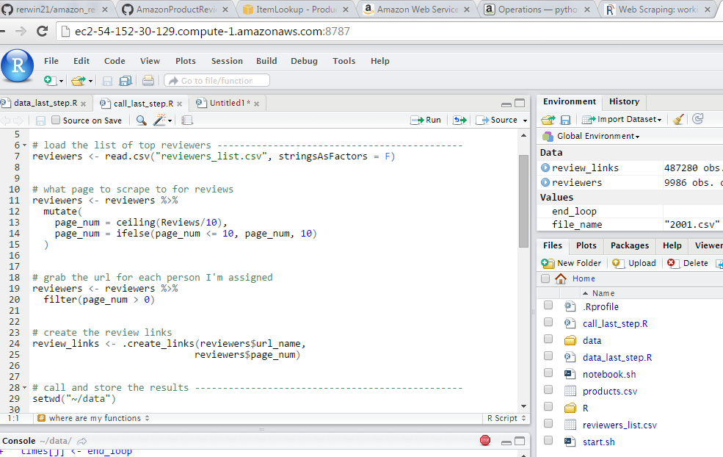
Installing R on AWS
sudo useradd rstudio
sudo mkdir /home/rstudio
sudo passwd rstudio
sudo chmod -R 0777 /home/rstudio
sudo apt-get update
sudo apt-get upgrade
sudo vi /etc/apt/sources.list.d/sources.list
deb http://mirrors.nics.utk.edu/cran/bin/linux/ubuntu trusty/
sudo apt-get update
sudo apt-get install r-base
sudo aptitude install libcurl4-openssl-dev
sudo apt-get install libxml2-dev
sudo apt-get install gdebi-core
sudo apt-get install libapparmor1
cd /tmp
wget https://download2.rstudio.org/rstudio-server-0.99.489-amd64.deb
sudo gdebi rstudio-server-0.99.489-amd64.deb

Slide 17
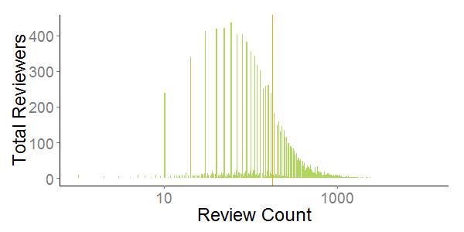
Analysis – Summary Stats & Reviews per Reviewer
Total Products Reviewed – ≈ 1 million
1.5% of reviews contained video reviews
Total Reviews – 1.7 million
Total Reviewers – 9,747
Review Count per Reviewer:
Min | 1st Qu. | Median | Mean | 3rd Qu. | Max
1 | 60 | 120 | 179 | 216 | 11,970

Slide 18
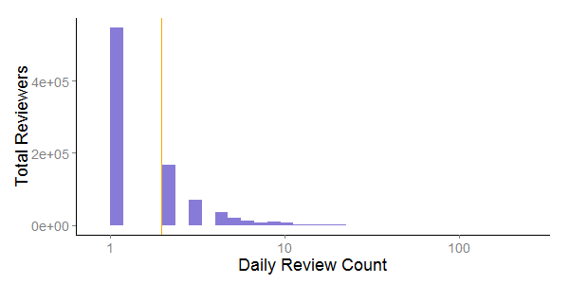
Analysis – Reviews per Day by Reviewer
Reviews written per day:
Min | 1st Qu. | Median | Mean | 3rd Qu. | Max
1 | 1 | 1 | 2 | 2 | 189

Slide 19
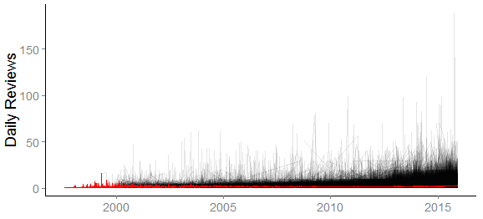
Analysis – Reviews per Day by Reviewer

Slide 20
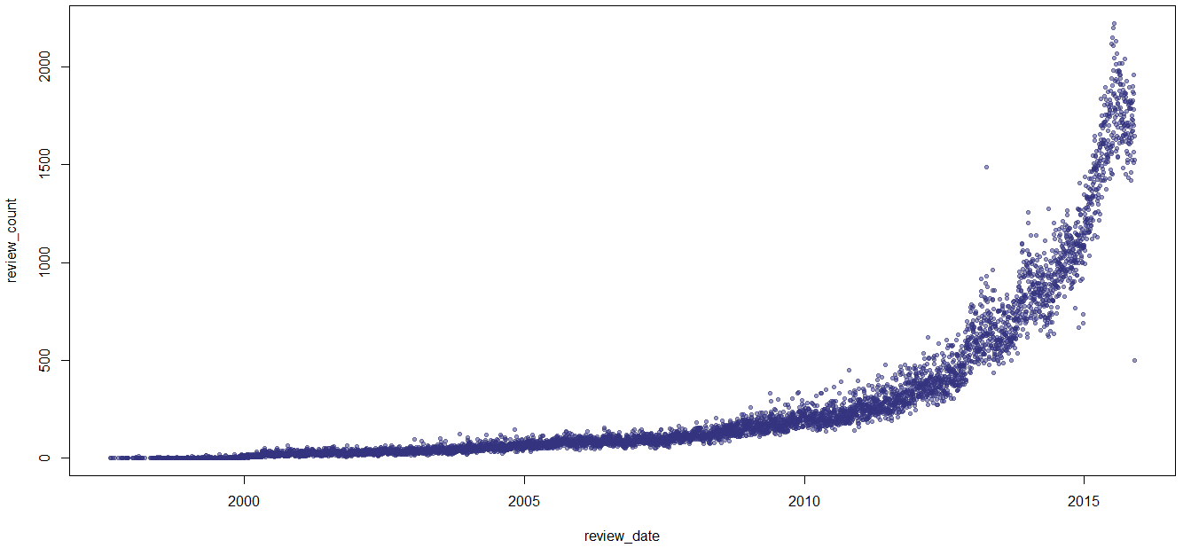
Analysis – Number of Daily Reviews for all Reviewers

Slide 21
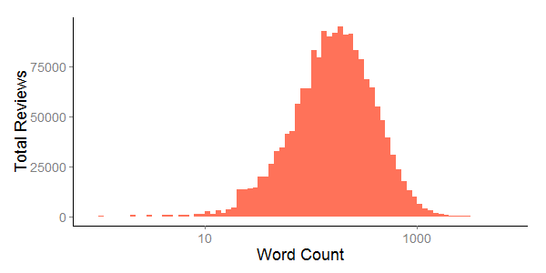
Analysis – Review Length
Word count of reviews:
Min | 1st Qu. | Median | Mean | 3rd Qu. | Max
1 | 92 | 168 | 229 | 295 | 5,992

Slide 22
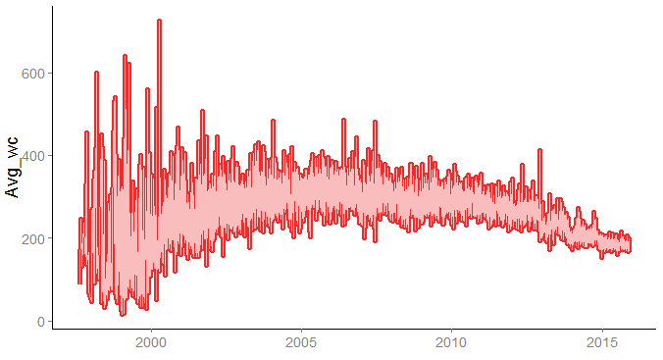
Analysis – Word Count by Day

Slide 23
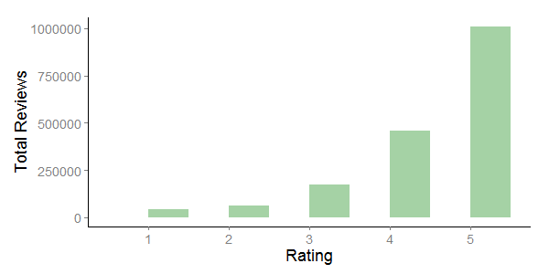
Analysis – Ratings
How are ratings distributed?
The top reviewers rarely give a bad rating

Slide 24
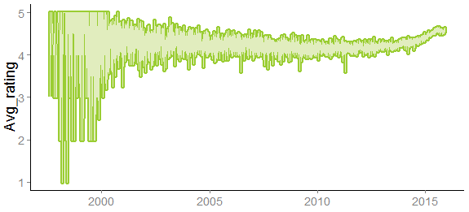
Analysis – Rating by Day

Slide 25
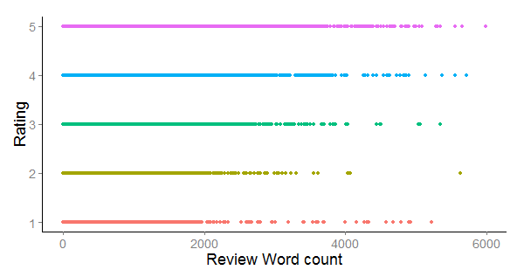
Analysis – Word Count and Product Rating

Slide 26
Next Steps
Product Advertising API
Price, category, etc.
Get more reviews for each product
Store data remotely and process remotely
More sophisticated modeling
Dependent on computing power
Most frequent words by product category

Slide 27
Miscellaneous
http://www.r-bloggers.com/instructions-for-installing-using-r-on-amazon-ec2/
Load packages on AWS instances
Use Product API to get the categories

Slide 28
Q&A

